Slide 1
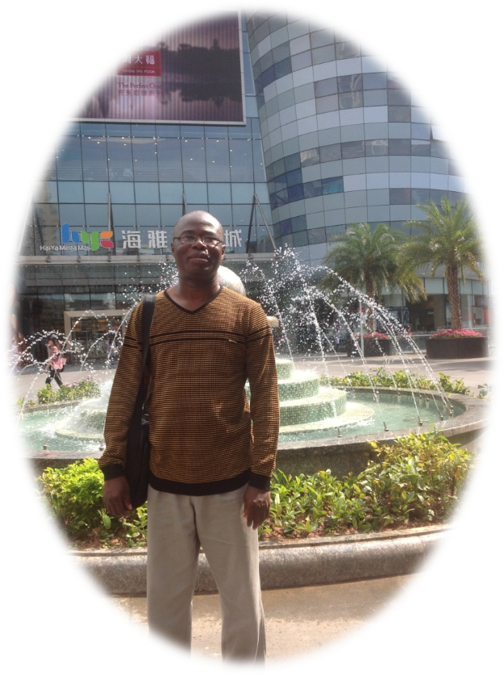
RIGHT ATTITUDINAL DEVELOPMENT TO LIFE GOAL ACHIEVEMENT
Graduate, Unemployment, Employability & Expected Skills
Prof. Dixon Olutade Torimiro, Ph.D.
Obafemi Awolowo University, Ile-Ife.
Email: torimiro@gmail.com
LinkedIn: Professor Dixon Olutade Torimiro
Skype: tade.torimiro
Facebook: Dixon Olutade Torimiro

Slide 2

INSPIRATION – NICK PRANGANATHAN

Slide 3







Ecclesiastes 3:1 – To every thing there is a season, and a time to every purpose under the heaven
70
60
50
40
30
20
10

Slide 4

INTRODUCTION
SLEEP
WORK
PLAY

Slide 5
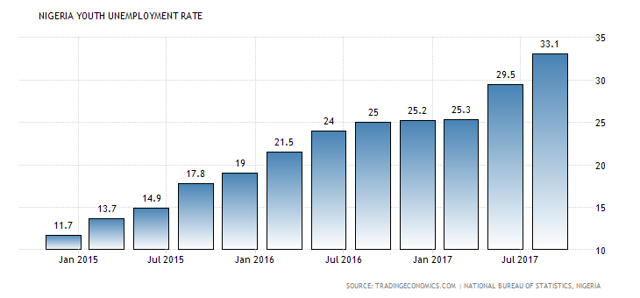
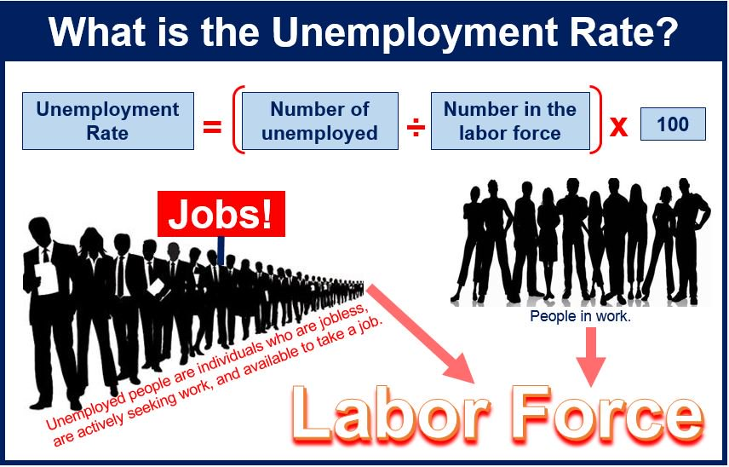
NIGERIA YOUTH UNEMPLOYMENT RATE

Slide 6
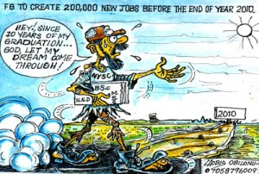
PROMISES OF JOBS!!!!!!!

Slide 7

DISAPPOINTMENTS!!!!!!

Slide 8

GOAL SETTING
WHAT DO YOU WANT TO ACHIEVE?

Slide 9

DON’T PLAY AROUND
….. BUT RATHER NET THE BALL

Slide 10


Yes, no employment! But if there is any, am I employable?

Slide 11


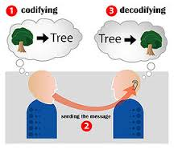
EXPECTED ATTRIBUTES OF A QUALITY GRADUATE
COMMUNICATION SKILL

Slide 12


NEGOTIATING
SKILL

Slide 13



VERSATILITY/MULTI-TASKING SKILL

Slide 14
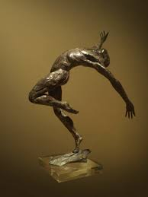

MALLEABLE/FLEXIBLE SKILL

Slide 15


LIFE-LONG LEARNING SKILL
Notes:
Torimiro, D.O. (2018): Right Attitudinal Development to Life Goal Achievement

Slide 16



ICT KNOWLEDGE AND USAGE SKILLS

Slide 17




CREATIVE/CRITICAL THINKING SKILLS

Slide 18



ENTREPRENEURSHIP /EMPLOYABILITY SKILLS

Slide 19
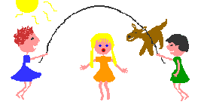


ORGANIZATIONAL/TEAM WORK SKILLS

Slide 20


RESEARCH AND INFORMATION LITERACY SKILLS

Slide 21
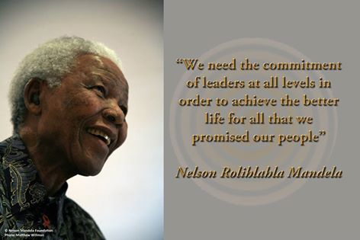
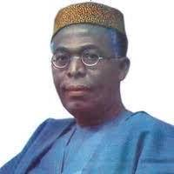

SOCIAL RESPONSIBILITY AND LEADERSHIP SKILLS

Slide 22
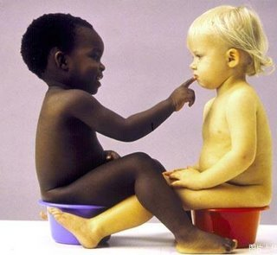


INTERPERSONAL/HUMAN RELATIONS SKILLS

Slide 23
SOME RIGHT ATTITUDES FOR DAILY GOAL ATTAINMENT
Plan each day
with God
Evaluate yourself at
the end of each day
Attend to your daily activities diligently
SURE
SUCCESS
Treat people with with love
& respect
Spend your
leisure
time wisely

Slide 24


…LIKE A PATIENT CONSULTING A MEDICAL DOCTOR
ALWAYS CONSULT FOR ADVICE.

Slide 25
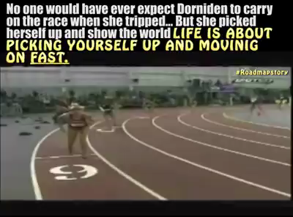
INSPIRATION - DORNIDEN

Slide 26

CONCLUSION
Worry about nothing, pray about everything,
and trust God for everything!!!
It is well!

Slide 27


THANK YOU
for
LISTENING

